Slide 1
Mathematical Economics
Lecture 11

Slide 2
Plan
Normed vector space
Bounded operator
Norm on the set of linear transformations

Slide 3

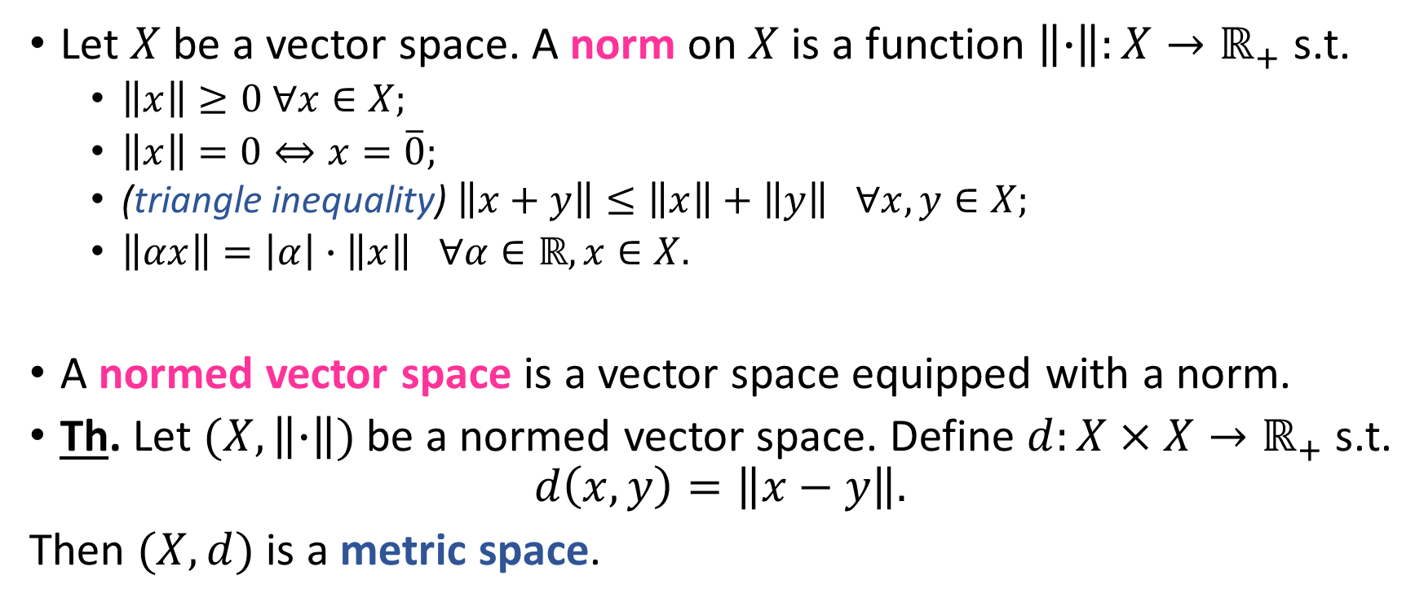
Normed Vector Space
Let $X$ be a vector space. A norm on $X$ is a function $\left\|∙\right\|:X→ℝ_{+}$ s.t.
$\left\|x\right\|≥0 ∀x∈X;$
$\left\|x\right\|=0⇔x=\overline{0};$
(triangle inequality) $\left\|x+y\right\|≤\left\|x\right\|+\left\|y\right\| ∀x,y∈X;$
$\left\|αx\right\|=\left|α\right|∙\left\|x\right\| ∀α∈ℝ,x∈X.$
A normed vector space is a vector space equipped with a norm.
Th. Let $(X,\left\|∙\right\|)$ be a normed vector space. Define $d:X×X→ℝ_{+}$ s.t.
$$d\left(x,y\right)=\left\|x−y\right\|.$$
Then $(X,d)$ is a metric space.
x
+y
+x
$$\overline{0}$$
+x+y
x+y

Slide 4
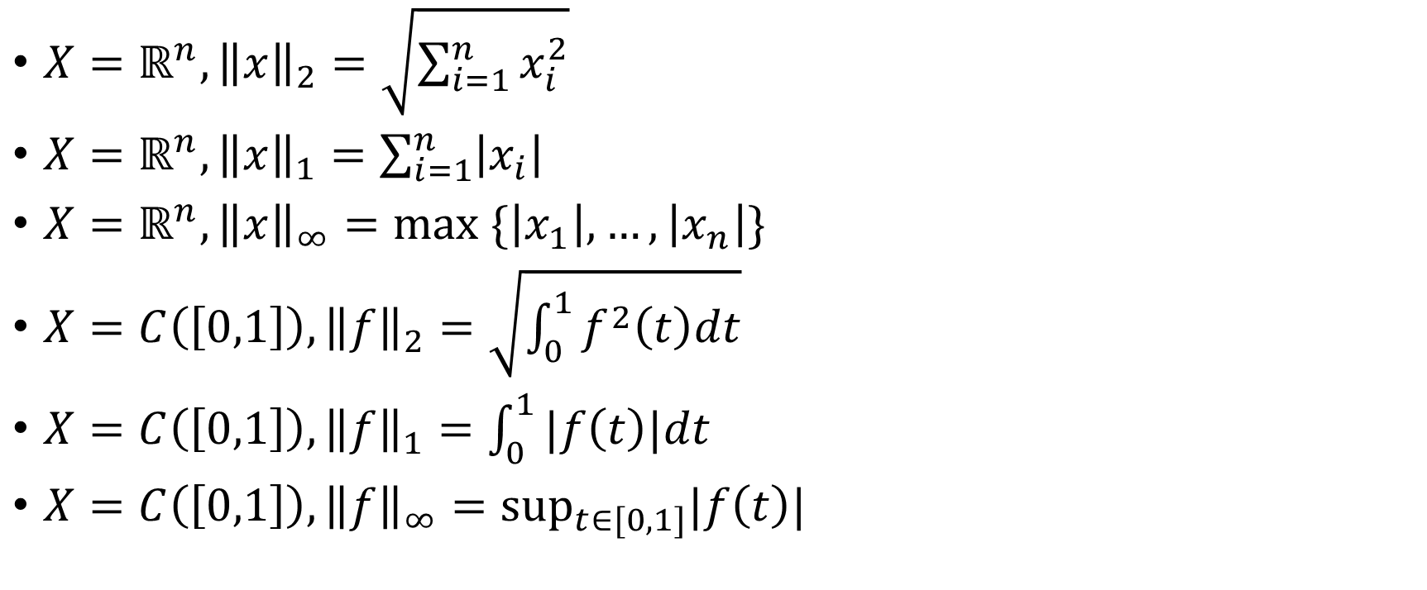
Normed Vector Space: Examples
$X=ℝ^{n}, {\left\|x\right\|}_{2}=\sqrt{\sum_{i=1}^{n}{x_{i}^{2}}}$
$X=ℝ^{n}, {\left\|x\right\|}_{1}=\sum_{i=1}^{n}{\left|x_{i}\right|}$
$X=ℝ^{n}, {\left\|x\right\|}_{∞}=\max_{ }{\{\left|x_{1}\right|,…,\left|x_{n}\right|\}}$
$X=C\left(\left[0,1\right]\right), {\left\|f\right\|}_{2}=\sqrt{\int_{0}^{1}{f^{2}\left(t\right)dt}}$
$X=C\left(\left[0,1\right]\right), {\left\|f\right\|}_{1}=\int_{0}^{1}{|f\left(t\right)|dt}$
$X=C\left(\left[0,1\right]\right), {\left\|f\right\|}_{∞}=\sup_{t∈[0,1]}|f\left(t\right)|$

Slide 5
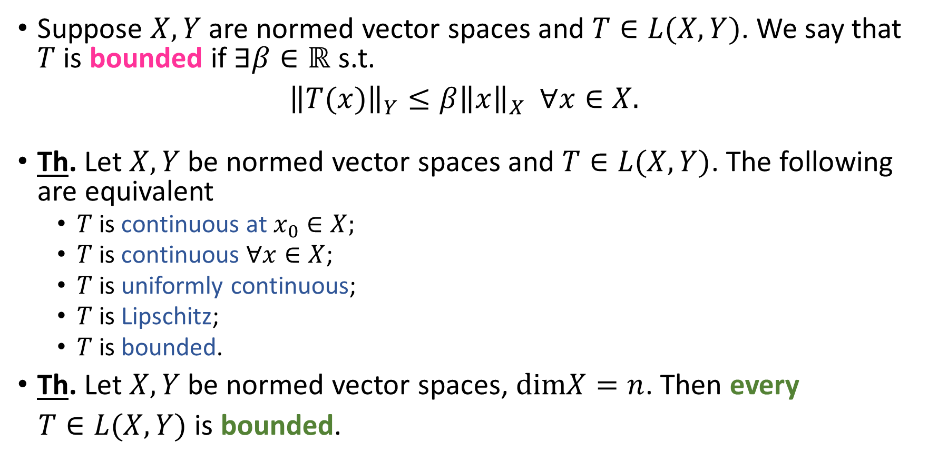
Bounded Operator
Suppose $X, Y$ are normed vector spaces and $T∈L(X,Y)$. We say that $T$ is bounded if $∃β∈ℝ$ s.t.
${\left\|T(x)\right\|}_{Y}≤β{\left\|x\right\|}_{X} ∀x∈X.$
Th. Let $X, Y$ be normed vector spaces and $T∈L(X,Y)$. The following are equivalent
$T$ is continuous at $x_{0}∈X;$
$T$ is continuous $∀x∈X$;
$T$ is uniformly continuous;
$T$ is Lipschitz;
$T$ is bounded.
Th. Let $X, Y$ be normed vector spaces, $dimX=n$. Then every
$T∈L(X,Y)$ is bounded.

Slide 6
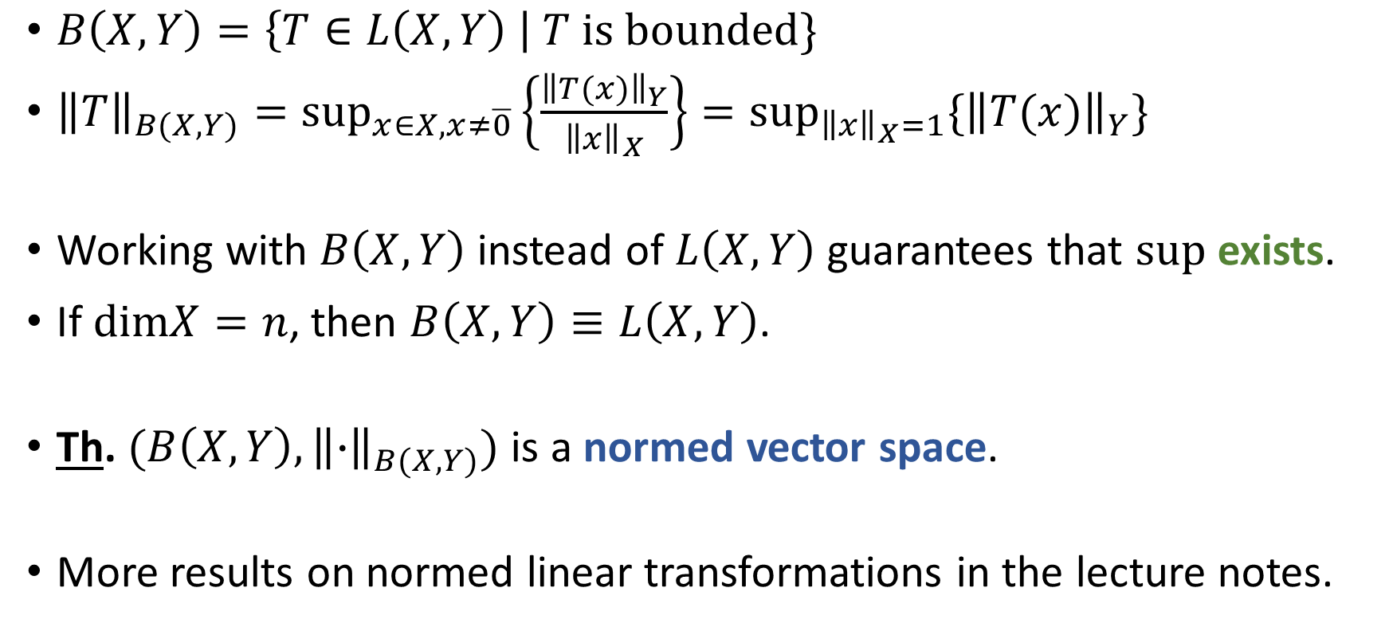
Norm on the Set of Linear Transformations
$B\left(X,Y\right)=\left\{T∈L\left(X,Y\right) \right| T is bounded\}$
${\left\|T\right\|}_{B(X,Y)}=\sup_{x∈X,x≠\overline{0}}\left\{\frac{{\left\|T(x)\right\|}_{Y}}{{\left\|x\right\|}_{X}}\right\}=\sup_{{\left\|x\right\|}_{X}=1}\{{\left\|T(x)\right\|}_{Y}\}$
Working with $B\left(X,Y\right)$ instead of $L\left(X,Y\right)$ guarantees that $sup$ exists.
If $dimX=n$, then $B\left(X,Y\right)≡L\left(X,Y\right)$.
Th. $(B\left(X,Y\right),{\left\|∙\right\|}_{B(X,Y)})$ is a normed vector space.
More results on normed linear transformations in the lecture notes.

